Slide 1
An Analysis of Diabetes Risk Factors Using Data Mining Approach
Although many studies employ several data mining techniques to assess the leading causes of diabetes, only small sets of clinical risk factors are considered.
In this study, we categorize our analysis into three different focuses based on the patients’ healthcare costs.
We examine whether more complex analytical models sing several data mining techniques in SAS® Enterprise Miner™ 7.1 can better predict and explain the causes of increasing diabetes in adult patients in each cost category.
The preliminary analysis shows that high blood pressure, age, cholesterol, adult BMI, total income, sex , heart attack, marital status, dental checkup, and asthma diagnosis are among the key risk factors.

Slide 2
1.INTRODUCTION
Preventing the disease of diabetes is an ongoing area of interest to the healthcare community.
Based on the data from the 2011 National Diabetes Fact Sheet, diabetes affects an estimate of 25.8 million people in the US, which is about 8.3% of the population.
Additionally, approximately 79 million people have been diagnosed with pre-diabetes .
Many studies regarding diabetes prediction have been conducted for several years.
The main objectives are to predict what variables are the causes, at high risk, for diabetes and to provide a preventive action toward individual at increased risk for the disease.

Slide 3
Previous studies employ several data mining techniques to assess the leading causes of diabetes
Lindstrom and Tuomilehto (2003) develop the diabetes risk score model considering Age, BMI, waist circumference, history of antihypertensive drug treatment, high blood glucose, physical activity, and daily consumption of fruits, berries, or vegetables as categorical variables
Park and Edington (2001) present a sequential neural network model for diabetes prediction.
The authors indicate risk factors, in the final model, including blood pressure, cholesterol, back pain, fatty food, weight index or alcohol index
Concaro et al, (2009) present the application of a data mining technique to a sample of diabetic patients.
They consider the clinical variables such as BMI, blood pressure, glycaemia, cholesterol, or cardio-vascular risk in the model.

Slide 4
Comparing previous studies and our studies based on CRISP-DM Model
Consequently, not only many potentially important variables such as pre-diabetes health conditions are neglected in their analysis, but the results produced by such techniques may not represent relevant risk factors and pattern recognition of diabetes appropriately.
In this study, we follow the CRISP-DM Model (Cross Industry Standard Process for Data Mining), which is used as a comprehensive data mining methodology and process model for conducting this data mining study.
CRISP-DM breaks down this data mining project in to six phases:
business understanding.
data understanding.
data preparation.
modeling,
Evaluation.
development.

Slide 5
2. RESEARCH FRAMEWORK
we begin our analysis by understanding the relevant data source, accessing data quality, and discovering first insights into the data.
The next step is toward data preprocessing from the initial raw data to the final dataset, ready for the model development. This preprocessing step takes about 90% of time to clean, transform, construct, and format the relevant data.
We then apply analytical data mining techniques to predict and explain factors that increase the prevalence of diabetes in the patient samples.
However, we need to evaluate and assess the validity and the utility of our developed predictive models before deploying the data mining results into the domain.

Slide 6
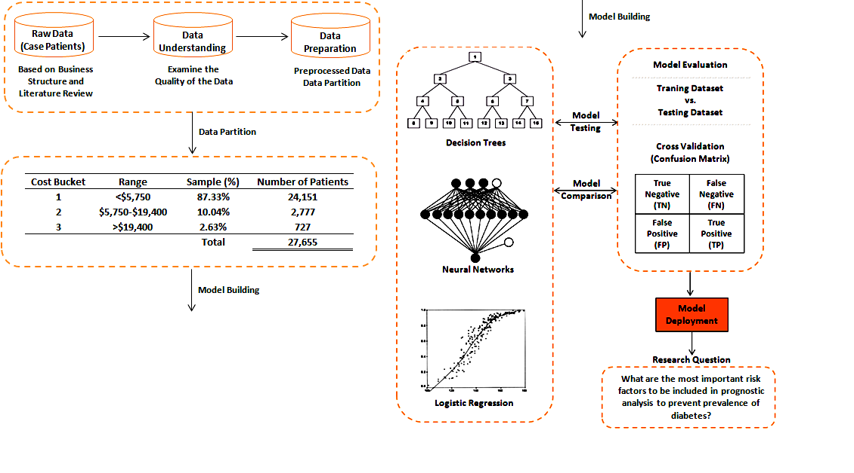
RESEARCH FRAMEWORK

Slide 7
3.Data Description
The data source that is used to perform data mining analysis in this study is provided by SAS in the national 2010 SAS Data Mining Shootout competition.
With 50,788 records, the dataset consists of 43 variables in which 35 variables are discrete variables and the other eight variables are continuous variables.
This dataset is assumed to be representative of the population and used for analysis as a snapshot of the country and its health care costs at a point in time.
Our first task in this study is to get a sense of the dataset for any inconsistencies, errors, or extreme values in the data.
Frequency distribution, descriptive statistics, and cross-tab analysis are used in this section.

Slide 8
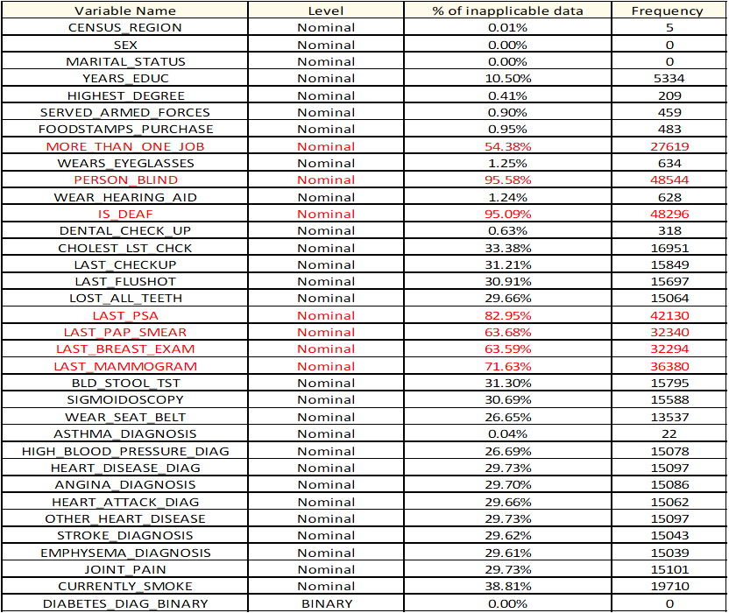
Summary of inapplicable data for nominal variables

Slide 9
3.Data Description
Below are the key findings, which are very important for data preparation in the next section:
- LAST_PSA, LAST_PAP_SMEAR, LAST_BREAST_EXAM, LAST MAMMOGRAM are only taken by one type of gender (Deleted).
- More than 95% of the data in PERSON_BLIND and IS_DEAF are inapplicable.
- 34.96% of patients with diabetes have no educational degree, compared to 17.81% of patients without diabetes
- 81.11% of patients with diabetes wear eyeglasses, compared to 44.58% of patients without diabetes
- 84.24 % of patients with diabetes checked their cholesterol within last year, compared to 31.79 % of patients without diabetes
- 83.20% of patients with diabetes checked their health within last year, compared to 38.92% of patients without diabetes
- 52.07% of patients with diabetes had flu-shot within last year, compared to 16.55% of patients without diabetes
- 32.48% of patients with diabetes had sigmoidoscopy or colonoscopy test, compared to 10.74% of patients without diabetes
- 63.23% of patients with diabetes have been diagnosed with high blood pressure, compared to 13.86 % of patients without diabetes
- 13.40% of patients with diabetes have been diagnosed with coronary heart disease diagnosis, compared to 1.57% of patients without diabetes
Based on these findings, we can observe that most diabetes patients have been diagnosed with other concurrent diseases such as high blood pressure, heart disease, and cholesterols, etc.

Slide 10
Data Preparation
We would like to figure out whether or not the data is complete or has missing values and what variables to be included in the model.
We make an assumption that the model excludes variables with over 50% information missing.
Thus, the following seven variables are excluded from our analysis:
(1) MORE_THAN_ONE_JOB
(2) PERSON_BIND
(3) IS_DEAF
(4) LAST_PSA
(5) LAST_PAP_SMEAR
(6) LAST_BREAST_EXAM
(7) LAST_MAMMOGRAM.

Slide 11
Data Preparation
For instance, a variable “PERSON_BLIND” has 48,544 missing observations (approximately 95% missing values) and out of its applicable data, there are only 37 observations indicating that those patients have been diagnosed with diabetes and blindness.
Even though there has been claimed that roughly 40% of patients diagnosed with diabetes in the United States have some form of diabetic retinopathy [5], we still exclude that variable from our analysis due to the relatively-low relevant amount of data in this dataset.
Another critical variable to be excluded from our analysis is “MORE_THAN_ONE_JOB.” There have been several studies on how unhealthy eating or sleeping habits (sedentary life styles) for those people that work more than one job increases the risk factor for diabetes .
Only approximately less than 0.3% (68 out of 23,169 observations excluding all non-applicable data) indicates the group of patients who have been diagnosed with diabetes and worked more than one job (see Figure 2).
Thus, we decide to exclude this variable from our analysis. Similar reasons for excluding such variable can be seen for the other five variables.
Additionally, including such variables with high-missing values in the model or even applying missing value imputation method can lower the quality of our findings.
In fact, we believe that the dataset is still quite large enough (over 30,000 observations) for the analysis after excluding these variables and any other missing values.

Slide 12
Cross-Tab Analysis (Diabetes by PERSON_BIND and Diabetes by MORE_THAN_ONE_JOB)

Slide 13
Data Preparation :Missing Values, Possible Outliers
After excluding suspected variables, we decide to impute missing values for better model prediction and to increase the total number of observations with diabetes.
Although, imputation can bias the model prediction, omitting these missing values in the sample dataset may also produce an extremely biased prediction when applied to the new dataset.
For interval input variables, the missing values are replaced with the mean of the non-missing values.
In contrast, the missing values for nominal variables are replaced with the most frequently occurring class variable value.
Another issue that should be addressed is the possible outliers in the data set. Some of the patients in the data set have income lower than zero.
Also some of the most expensive patients have the total health care cost, Medicaid, or Medicare within very extreme percentile.
In our model, we decide to filter the patients with these outliers out of the data set. Consequently, a total of 27,655 observations are ready for modeling analysis.

Slide 14
Data Preparation :Data Transformation
Initially, we decide to transform the variables, which look right skewed, in order to improve the fit of a model to the data.
We apply “Maximize Normality” method to the following six variables:
AMOUNT_PAID_MEDICAID
AMOUNT_PAID_MEDICARE
NUMBER_VISITS
ADULT_BMI
TOTALEXP
TOTAL_INCOME.
However, it seems that only TOTAL_INCOME and NUMB_VISITS show significant improvement after the transformation, while the distribution of other variables remain closely the same. Thus, only TOTAL_INCOME and NUMB_VISITS variables are transformed for further analysis.

Slide 15
Data Preparation : Variable Transformation Statistics

Slide 16
3. PREDICTION MODEL
In this study, three popular data mining techniques including logistic regression, decision tree, and artificial neural network are applied and compared to each other based on their predictive accuracy on the hold-out sample.
Logistic regression is often used to predict an outcome variable that is binary or multi-class dependent variables.
It allows the prediction of discrete variables (dependent variables) by a mix of continuous and discrete predictors as the relationship between dependent variables and independent variables is non-linear.
It builds the model to predict the odds of its occurrence instead of point estimate event in the traditional linear regression model.
Decision tree is another data classification and prediction method commonly used due to its intuitive explainability characteristics.
Decision tree divides the dataset into multiple groups by evaluating individual data record, which can be described by its attributes.
It is also simple and easy to visualize the process of classification where the predicates return discrete values and can be explained by a series of nested if-then-else statements.
Artificial Neural Network (ANN) is a mathematical and computational model for pattern recognition and data classification through a learning process.
It is a biologically inspired analytical technique, simulating biological systems, where learning algorithm indicates how learning takes place and involves adjustments to the synaptic connections between neurons. Data input can be discrete or real valued; meanwhile the output is in a form of vector of values and can be discrete or real valued as well.

Slide 17
Cost Bucketing and Model Classification
In this study, we categorize our analysis into three different focuses based on the patients’ healthcare costs.
We partition our patients into these three groups in such a way that the sum of all patients’ healthcare costs in each group is approximately the same.
The range of healthcare costs is varied significantly. According to the population’s cumulative healthcare expenses, approximately 87% of the overall expense of the population originates from only 3% of the most expensive patients.
The cost bucket #1 can be interpreted as candidates for the low-risk group of patients diagnosed with diabetes.
The cost bucket #2 can be interpreted as the pre-diabetes group.
The cost bucket #3 can be interpreted as the high-risk group of patients diagnosed with diabetes.

Slide 18
Cost bucket information

Slide 19
Cost Bucketing and Model Classification
We decide to stratify our samples to construct a model set with approximately equal numbers of each target value (DIABETES_DIAG_BINARY) in each cost bucket.
With a 50% adjusting for oversampling, we believe that the contrast between the two values is minimized, which make it easier and more reliable to recognize patterns in this dataset.
The most important goals of this study are to predict the outcome probability of people with diabetes.
In order to provide more accurate diabetes prediction, we apply and compare ANN, Logistic Regression, and Decision three models in each cost bucket as well.

Slide 20
Performance Measures
The complicity of the model is controlled by fit statistics calculated on the testing dataset.
We use three different criteria to select the best model on the testing dataset.
These criteria include false negative, prediction accuracy, and misclassification rate.
False negative (Target = 1 and Outcome = 0) represents the case of an error in the model prediction where model results indicate that diabetes occurrence is not present, when in reality, there is an incident.
The false negative value should be as low as possible.
The proportion of cases misclassified is very common in the predictive modeling.
However, the observed misclassification rate should be also relatively low for model justification.
Lastly, prediction accuracy is evaluated among the three models on the testing dataset.
The higher the prediction accuracy rate, the better the model to be selected.

Slide 21
4. RESULTS AND DISCUSSIONS
After excluding variables with outliers and high missing values, we first develop predictive models on the original sample dataset without categorizing our sample into three cost-bucketing groups .
The results of the overall model are compared to those from each cost-bucketing group to determine whether important risk factors of diabetes are different.
The dataset is allocated to the training (70%) and testing (30%) partitions.
The binary variable of patients with diabetes (Target = 1 for patients with diabetes and Outcome = 0 for patients without diabetes) is the output variable of the prediction models.
After recoding all categorical input variables, the selected variables are tested whether the association between the input variables and the logit of binary target variable satisfy the linearity assumption.
The problematic variables are then transformed to satisfy such assumption.
Different models are constructed and compared in order to predict patients with diabetes.
Training dataset is only used to extract models by the data mining algorithms.
Then, those models derived in the training data set are then applied on the testing dataset for the correct discovery of intrusions. In other words, this testing dataset is used to prune the models generated by the data mining process in the training dataset to avoid overfitting and instabilities in the classification accuracy.
Statistical analyses are performed using SAS® Enterprise Guide 4.3 for data preparation and SAS® Enterprise Miner™ 7.1 for model development and comparison.

Slide 22
Overall Model
Logistic regression produces the best results with overall misclassification rate of 22.89%.
Although Artificial Neural Networks (ANN) has the lowest false negative rate of 20.55%, we still select the logistic regression model as our final model to predict patients with diabetes.
After performing the stepwise logistic regression, which is a process of building a model where the choice of predictive variables is carried our based on the t-statistics of their estimated coefficients, the final model is presented.
There are total 15 risk factors used to predict the prevalence of diabetes.

Slide 23
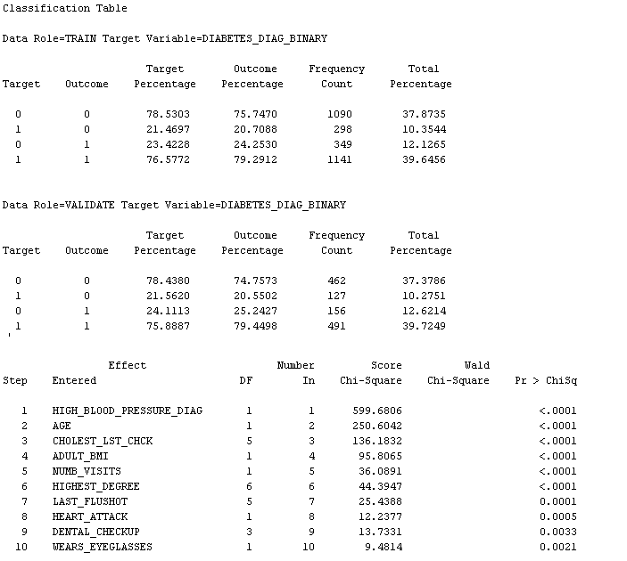
Classification Table and Summary of Stepwise Selection (Overall Model)

Slide 24
Cost Bucket #1 (<$5,750)
For the low-risk group (Cost Bucket #1), Decision tree produces the best results with overall misclassification rate of 24.56%,
followed by the Logistic regression and artificial neural networks with misclassification rates of 25.43% and 25.68%, respectively.
Seven variables including age, cholesterol, adult BMI, high blood pressure, total income, sex , and asthma diagnosis are important factors to predict diabetes in this cost bucket group.
Compared to the overall model, Only age, high blood pressure, and cholesterol are the common risk factors.

Slide 25
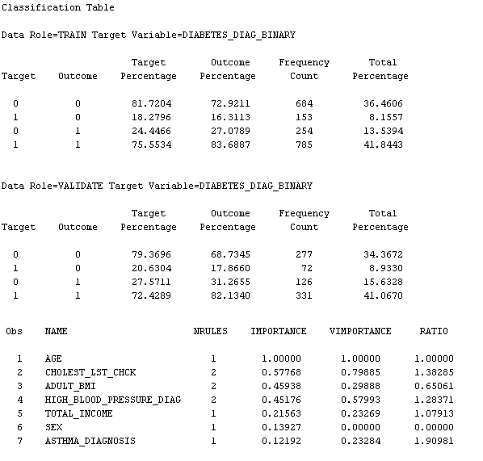
final variable selection and classification table for Decision Tree model-Classification Table and Variable Importance (Cost Bucket #1)

Slide 26
Cost Bucket #2 ($5,750 - $19,400)
For the pre-diabetes group, Logistic Regression produces the best results with overall misclassification rate of 29.74%, followed by artificial neural networks and decision tree, respectively.
Eight variables including cholesterol, adult BMI, high blood pressure, highest degree, last flu shot, heart attack, wears eyeglasses, and marital status are important factors to predict diabetes in this cost bucket group.
Compared to the overall model, adult BMI, high blood pressure, last flu shot, heart attack, wears eyeglasses, and marital status are the common risk factors.
On the other hand, only adult BMI and high blood pressure are the common risk factors between this group and the cost bucket #1.

Slide 27
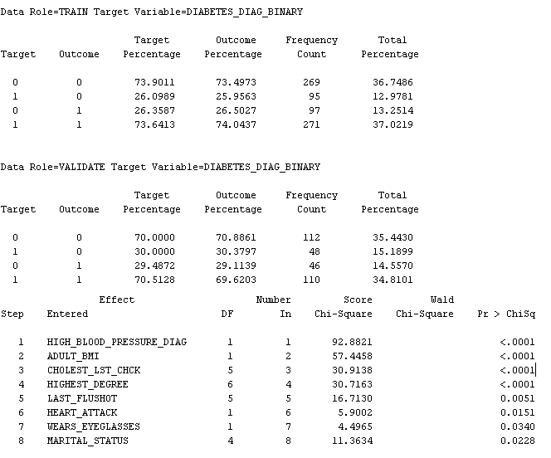
final variable selection based on the stepwise regression approach and classification table for Logistic regression model-Classification Table and Summary of Stepwise Selection (Cost Bucket #2)

Slide 28
Cost Bucket #3 (>$19,400)
For the high-risk group, Decision Tree produces the best results with overall misclassification rate of 41.80%,
followed by artificial neural networks and Logistic Regression, respectively.
The final model indicates that adult BMI, age, wear eyeglasses, and marital status are among the key risk factors in this cost bucket group.
Compared to the overall model, adult BMI, age, and, wears eyeglasses are the common risk factors.
On the other hand, only adult BMI and age are the common risk factors between this group and the cost bucket #1;
meanwhile adult BMI, wears eyeglasses, and marital status are the common risk factors compared to the cost bucket #2

Slide 29
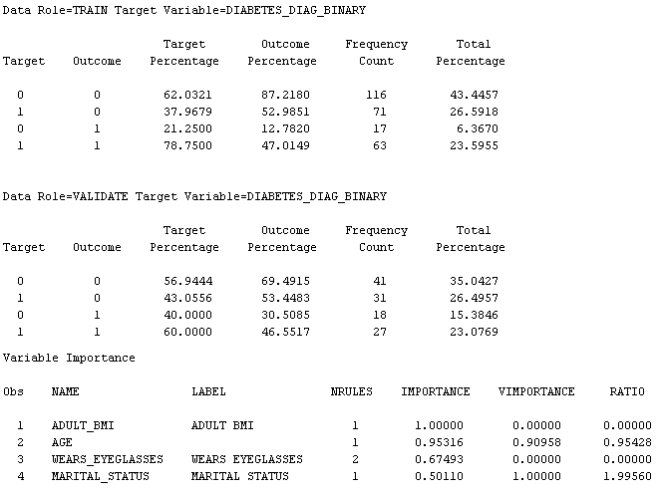
final variable selection and classification table for Decision Tree model- Classification Table and Variable Importance (Cost Bucket #3)

Slide 30
5. CONCLUSION
This study demonstrates that data mining based approaches can be used to assess predictor variables influencing the risk of diabetes in adult patients.
As opposed to the traditional descriptive statistical analysis methods or the approaches adopting only expert-selected variables, the employment of logistic regression, decision trees, or neural network models provide an interesting list of risk factors that some have been included in the existing studies;
meanwhile some others have been absent from the related literatures.
We categorize our analysis into three different focuses based on the patients’ healthcare costs.
Only adult BMI is the key risk factor among these four groups.
Age is the most important factor for the overall model, cost buckets #1, and # 3;
meanwhile, high blood pressure is the key indicator for the overall model, cost buckets #1 and #2.
The results presented confirm the previous literature to some extent.
The following key risk factors: High blood pressure, adult BMI, cholesterol, and heart attack derived from our analysis are consistent with the studies from Lindstrom and Tuomilehto (2003), Park and Edington (2001), and Concaro et al. (2009).
On the other hand, several interesting factors such as total income, asthma diagnosis, wears eyeglasses, and marital status reported to be critical in this study have not been included in the existing studies.

Slide 31
Summary of the Key Findings

Slide 32
THE END
THANK YOU

